Slide 1
Relative Velocity

Slide 2
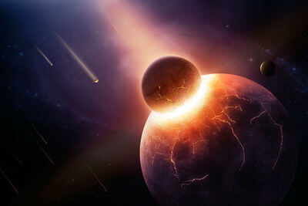
Welcome to this Smart Lesson on velocity!
After completing this Smart Lesson you will be able to:
State the velocity of an object.
Solve problems involving subtracting vectors.
Calculate the velocity of an object relative to an observer.
Calculate relative velocity in two dimensions.

Slide 3

In this lesson we will be learning about velocity in the context of a tournament.
A tournament is a competition or pretend fight between medieval warriors.
Tournaments were held primarily for entertainment. The most popular event was the melee, where participating knights would be divided into two groups. The two groups would crash together on horseback in an attempt to break the other formation, or push them back.
In this lesson we will focus on a minor aspect of a tournament, the joust. Jousting is where two knights charge at each other in single combat.

Slide 4
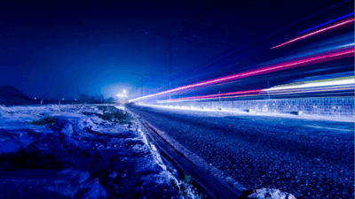
Just as displacement is made up of distance and direction, velocity is made up of speed and direction of motion.
The speed of an object is how fast the distance to the object is changing over time. Speed is a scalar.
The velocity of an object is how fast the displacement of the object is changing over time. Velocity is a vector.
Both speed and velocity are measured in metres per second (ms⁻¹).

Slide 5
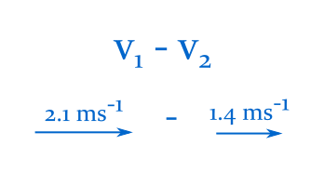
In this section we'll learn how to subtract vectors.

Slide 6
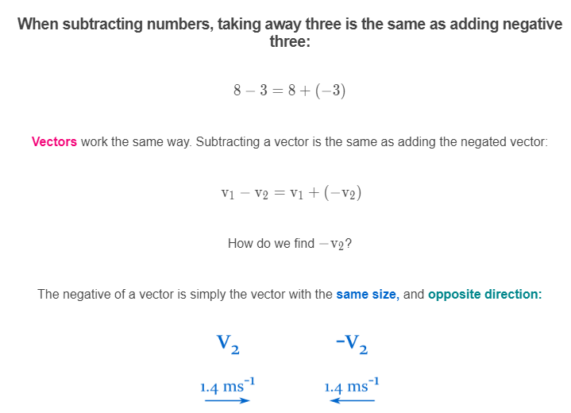

Slide 7
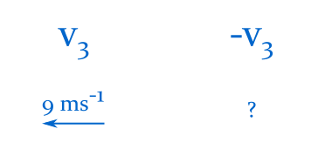
Example
What is the negative of the vector below?

Slide 8
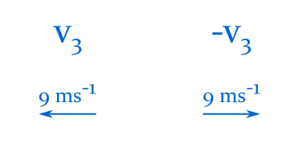
Solution
The negative of the vector below is 9 ms−1 to the right.
The negative of a vector has the same size, and opposite direction.

Slide 9
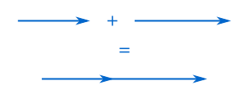
Adding vectors.
Adding two vectors together yields another vector, with a size and direction of its own.
Vectors are added by connecting the arrowhead of one vector to the tail of a second vector. The sum of the two vectors is the distance and direction from the tail of the first, to the tip of the second:

Slide 10
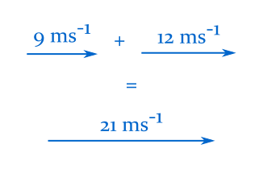
When two vectors are parallel and point in the same direction, calculate the new size by adding the two vectors together.
For example, in the image below the new vector is 21 ms⁻¹ to the right.

Slide 11
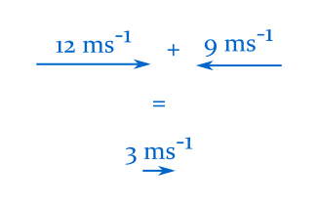
When two vectors are parallel and point in opposite directions, calculate the new size by subtracting the size of the smallest vector from the size of the largest vector.
The new direction is simply the direction of the largest vector.
For example, in the image below the new vector is 3 ms⁻¹ to the right.

Slide 12

Example
What is the difference between the two vectors below?

Slide 13
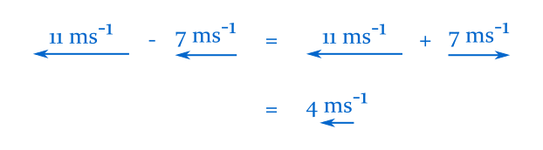
Solution
The difference between the two vectors is 4 ms⁻¹ to the left.
Negate the second vector, then add it to the first:

Slide 14
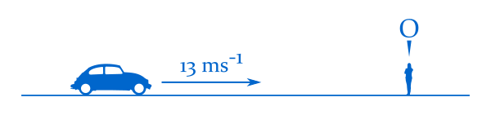
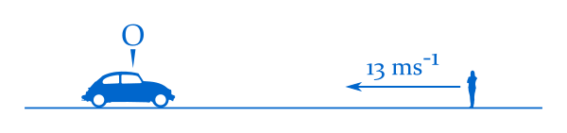
Relative motion.
Until now we have always described speed and velocity relative to the ground. We always assume that the ground is not moving.
In real life, objects appear to move at different speeds depending on how fast you are moving.
From a pedestrian's perspective, cars look like they're moving past at high speed. From a motorist's perspective, pedestrians look like they're moving past the car.
In the diagram above, the pedestrian observes the car. In the diagram below, the car observes the pedestrian.

Slide 15
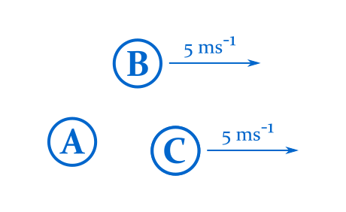
The diagram below depicts the velocities of a few objects relative to the ground.
The velocity of A is zero, and the velocities of B and C are 5 ms⁻¹ to the right.

Slide 16
The velocity of an object looks different depending on where it is measured from.
Let's observe the relative velocity of some of the objects below.
Relative to object A, object B is moving at 5 ms⁻¹ to the right.
This is quite natural. Object A isn't moving, and object B is. Of course object A sees object B in motion.

Slide 17
What about the relative velocity of B and C?
Objects B and C have the same velocity. As time progresses, objects B and C will continue to move side by side, and not get any closer or further away from each other.
Relative to object C, object B is not moving.

Slide 18
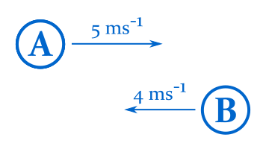
Let's look at two new objects that are moving in opposite directions:
To find the velocity of an object relative to another, subtract the velocity of the observer from that of the observed object.

Slide 19
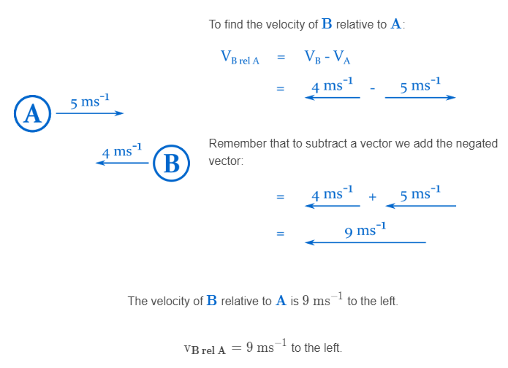

Slide 20
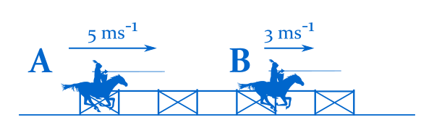
Example
Two knights are practising their jousting runs.
Knight A is travelling at 5 ms⁻¹ to the right, and knight B is travelling at 3 ms⁻¹ in the same direction.
What is the velocity of knight B relative to knight A?

Slide 21
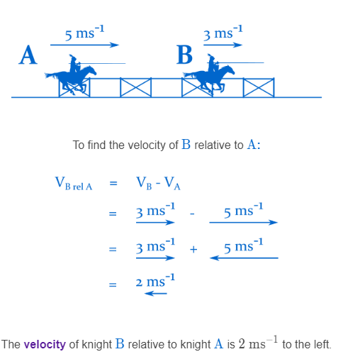
Solution
To find the velocity of an object relative to another, subtract the velocity of the observer from that of the observed object.

Slide 22
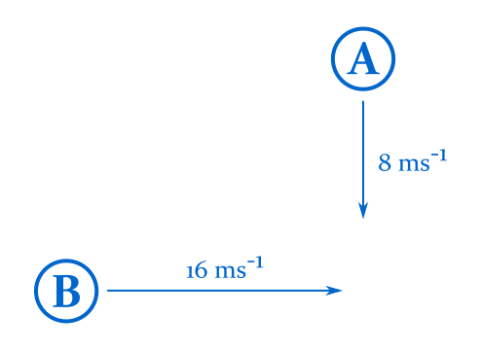
In this section we'll learn how to calculate relative velocity in two dimensions.

Slide 23
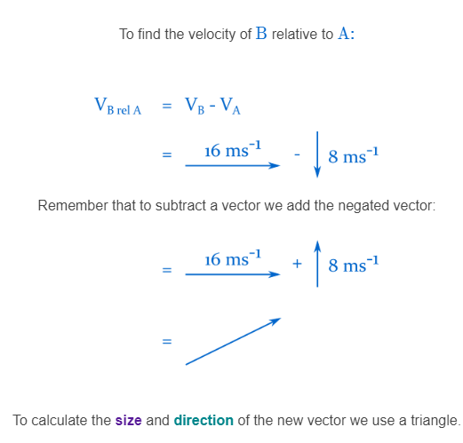
Just as for one dimension, to find relative velocity in two dimensions, subtract the velocity of the observer from the velocity of the observed object.

Slide 24
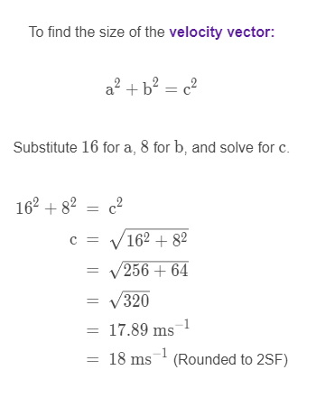
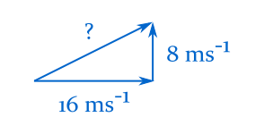
To find the size of the velocity vector we use Pythagoras' theorem.

Slide 25
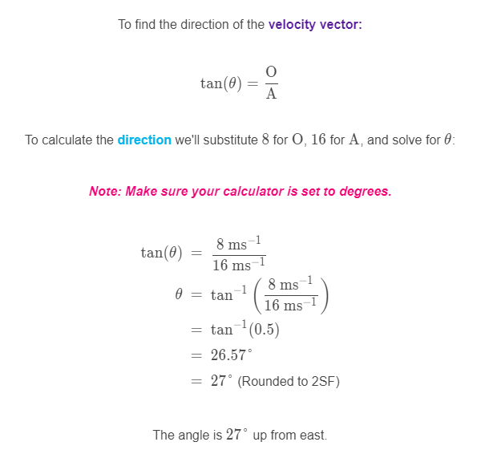
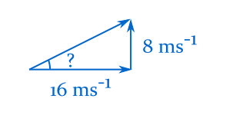
Now that we have found the relative velocity vector, we can calculate the direction of the vector with trigonometry.

Slide 26
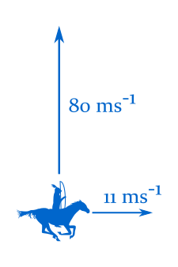
Example
An archer on horseback rides east across the field at 11 ms⁻¹.
She fires an arrow at a target to the north. The arrow travels at 80 ms⁻¹.
What is the velocity of the arrow relative to the ground?

Slide 27
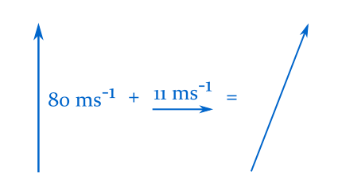
Solution
As the arrow is fired from an object that's moving relative to the ground, the arrow's velocity relative to the ground is the sum of the two velocities.

Slide 28
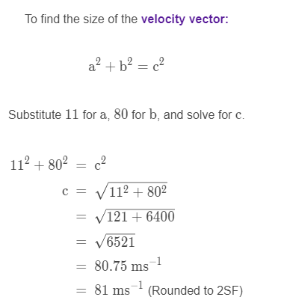
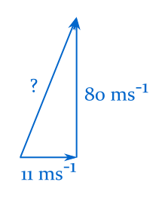
Solution

Slide 29
